Slide 1

Energy consumption analysis of a Smart Meter dataset
Springboard Capstone project
Jorge Moscat (BCG sponsored)
July 2016

Slide 2
Agenda
Introduction: Objectives and overview of the dataset
Exploratory Analysis: Reduced dataset
Deep-dive analysis: Madrid customers

Slide 3
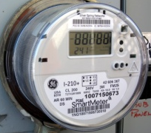


Understanding the scope and objetives of the analysis
The Data Set
Goals
Analysis of a publicly available dataset published by Endesa¹ (electricity company) with following characteristics
>7GBs of smart meter readings (i.e. household's energy consumption readings)
More than 100k customers from Spain
Detailed information about products types, customer's basic characteristics etc.
Data ranges from March 2013 to October 2015
For each customer included, there are daily 1-hr interval energy readings
Select smaller subset of dataset to be analyzed in R
Exploratory analysis and visualization of subset dataset
Determine relation between weather and energy consumption
Model customers' behavior: weekly energy usage
Identify when customers are away from home based on usage analysis
Smartmeter
Endesa Dataset
1. The original dataset was published in this website (http://www.endesaenergychallenges.com/datathon/) but since the datathon has officially ended, the download link is not available anymore.

Slide 4
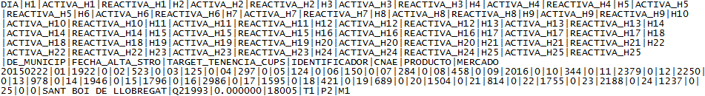
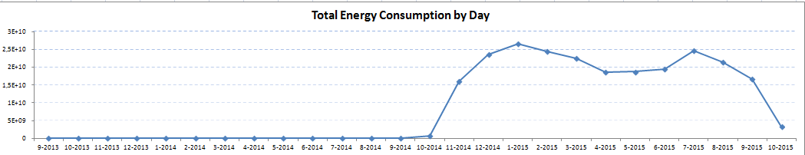
Endesa's smartmeter readings
Data set overview
Dataset was made available on Endesa's website as part of an open competition (Datathon¹ ) to identify the top most innovative ways to analyze this kind of data. The dataset was downloadable from their site or accessible through an open API.
Format: Pipe-delimited dataset (i.e. "|")
Size: 7.5GB single file (32millon records)
Geographical scope: data from 808 municipalities in Spain
Total Customers: >100k unique customers ( which is <1% of Endesa's customer base)
Raw extraction
Initial exploration
Plot created using Alteryx
1. http://www.endesaenergychallenges.com/datathon/

Slide 5
Overview of the field structure of the dataset
Fields included in analysis
CLIENT_ID: The unique, customer reference number which allows for segmentation of usage per customer.
DAY: The date on which the energy usage occurred, in the following format: YYYY/MM/DD
H1, H2,…, H25: The time at which the energy usage occurred. There are 25 entries due to the time change when the clocks are set back one hour on the last Sunday of October each year, which leads to a total of 25 hours on this day.
CITY: The municipal district to which the customer belongs. Geographical reference.
ACTIVA_H1, ACTIVA_H2,…, ACTIVA_H25: Active energy consumed per hour as measured in kWh (kilowatt-hour). This is the useful energy that the customers absorb from the grid and transform into work and/or heat at home.
CNAE: (National Classification of Economic Activities) This value indicates whether the customer is domestic (T1) or not (T2).
PRODUCT: Tariff / electrical product that the customer has contracted; there are up to 120 products.
MARKET: This value indicates whether the customer has a regulated tariff (M1) or a free market tariff (M2). Regulated Tariff: the price of the electricity is regulated periodically by the corresponding authority. Free market: the price of the electricity is freely agreed upon by the provider and the customer.
REACTIVA_H1, REACTIVA_H2,…, REACTIVA_H25: Reactive energy consumed per hour in VArh (volt-ampere-hours). This is a supplementary usage that the customers cannot take advantage of. Currently reactive energy consumption is not billed, although it could be charged for in future as a way of improving the energy efficiency of homes.
FECHA_ALTA_STRO: Date on which the customer´s service was activated with the following format: QXAAA
TARGET_TENENCIA_CUPS: Probability that the municipal district in question is already equipped with a natural gas distribution network (which does not imply that the customer had contracted natural gas service).
Only included in analysis "Domestic clients" (T1)
Only included in analysis "free market" tariff (M2)

Slide 6

Using command-line tools to select a subset for analysis in R
The challenge: Loading the full dataset (>7.5GB) on R was not a viable option since R loads up all the data into memory and PC used for analysis only had 2GBs of RAM
The workaround: Leveraging command-line tools it is possible to wrangle the dataset without the need to load up the whole file into memory. I used xxx and CSVKIT to
Convert file from pipe-delimited format to comma-separated
Select a subset of the full file to start the exploratory analysis
Full Dataset
Subset
Filter
Reduced subset
60MBs of data
7757 unique clients
Full dataset
7.5GBs of data
>100k clients
Command tools used:
sed: to convert pipe-delimited to csv
csvkit: Data filtering on csv file
Criteria used for filtering:
Cities: Selected 10 municipalities
Dates: Jan '15 and Jul '15
Market: Free market (M2)
CNAE: Domestic (T1)

Slide 7
Agenda
Introduction: Objectives and overview of the dataset
Exploratory Analysis: Reduced dataset
Deep-dive analysis: Madrid customers

Slide 8
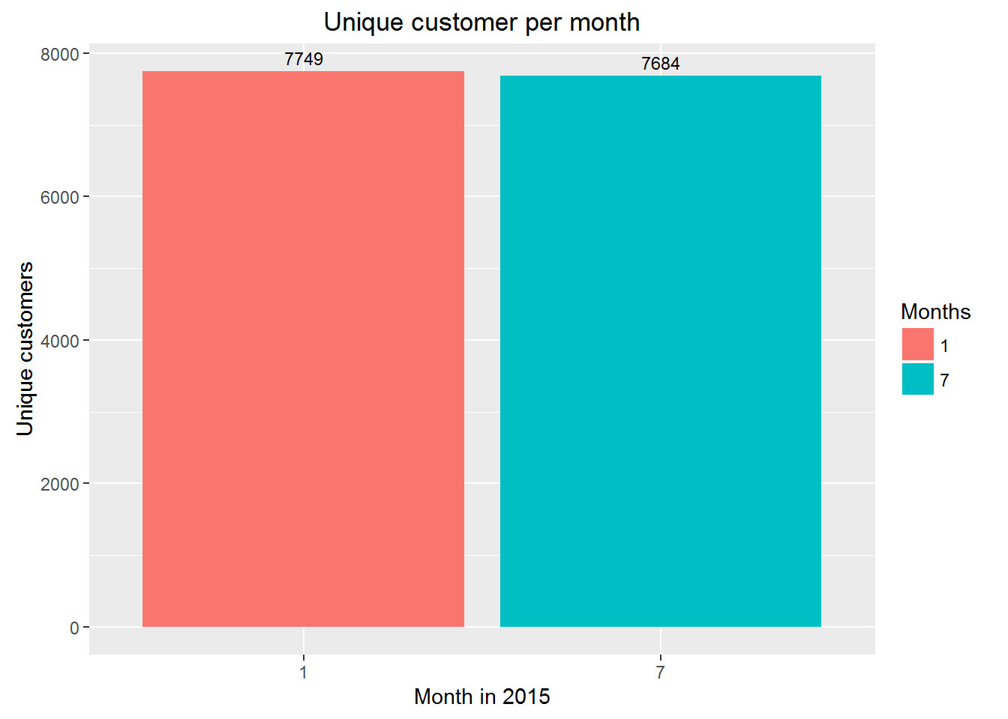
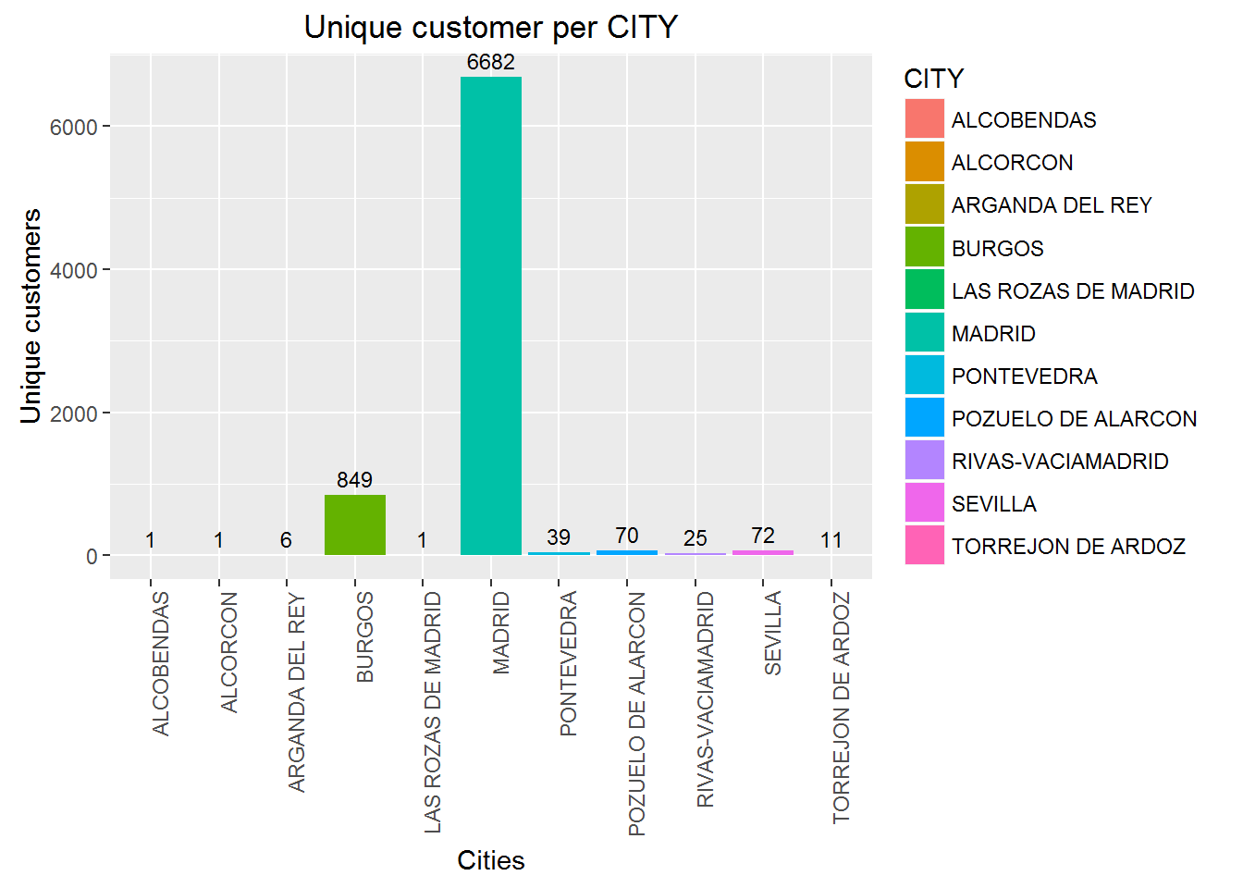
>87% of the customers in our dataset are from Madrid
Customers per Month
Customer per City
Slight difference in the total number of unique customers between January and July
7749 customers in Jan vs. 7684 in July
Out of the 10 municipalities we selected in our dataset, Madrid is the one with most customers
Our reduced dataset contains 6682 customers from Madrid (>87% of the total)

Slide 9
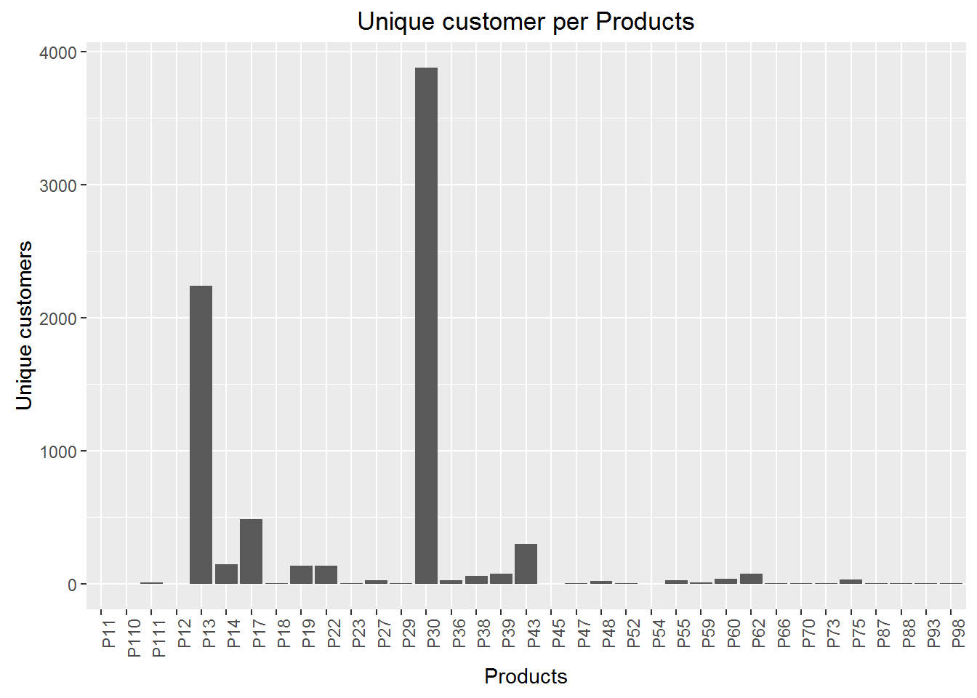
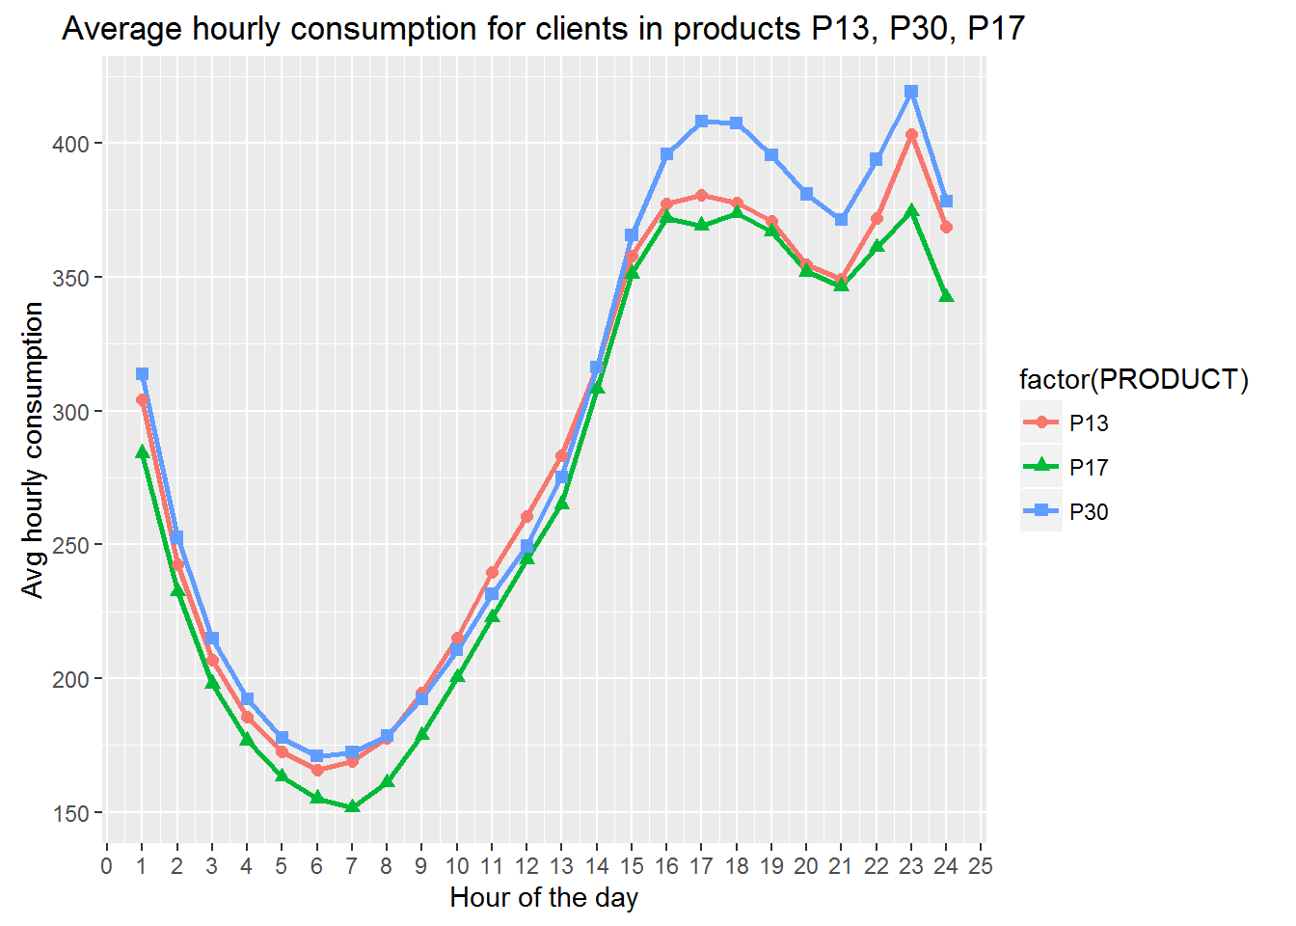
Most of the customers have contracted either products P30, P13 or P17 and exhibit similar usage pattern
Hourly usage difference between
main products
Unique customers per product
In our reduced dataset we can find customers assigned to a wide variety of products
37 different products
Products P30, P13 and P17 are the most popular
Plot below shows average energy consumption per hour for products P13, P30, P17
Overall, these 3 products show similar usage pattern
P30 seems to have a higher rate of electricity usage in the afternoon
P30 customers consume more energy overall

Slide 10
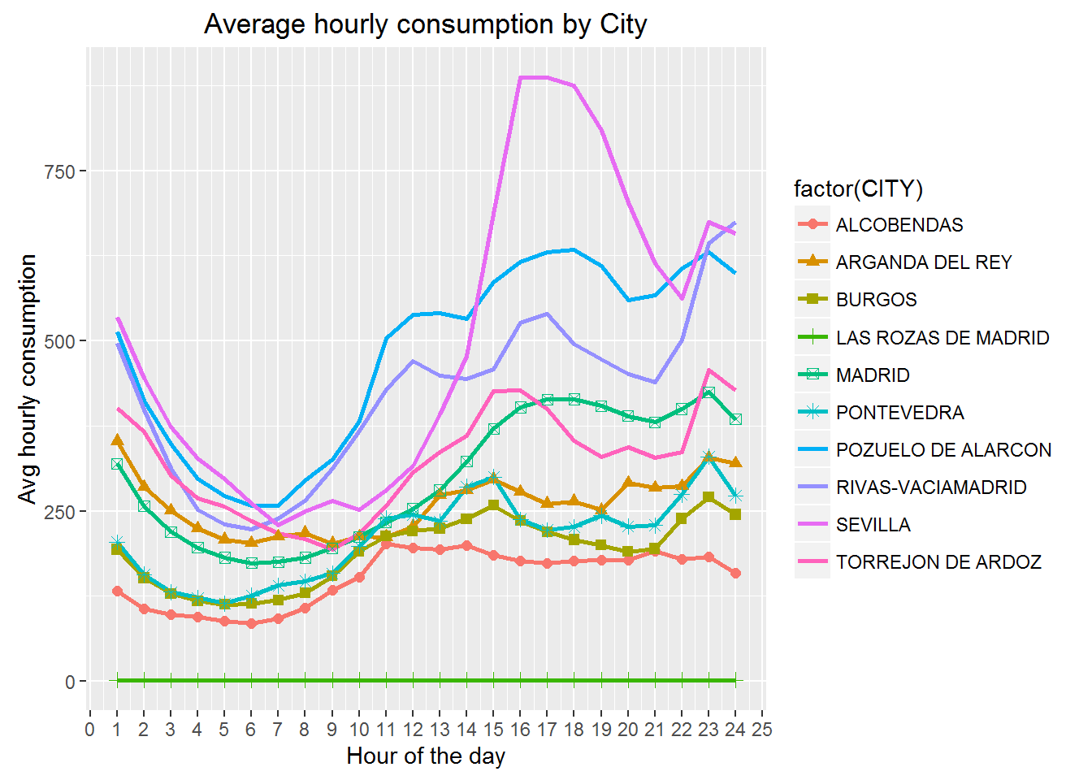
Across 10 cities selected in our dataset, the daily peak of electricity consumption occurs on average at ~23:00
Aggregated average hourly energy
consumption (month of July)
Key observations
Sevilla¹ is a clear outlier with a significantly high peak at 16:00-18:00, probably due to high AC usage:
Seville is one of the hottest places in Spain
16:00-18:00 are central hours of the day, the hottest moment in the day
Pozuelo de Alarcon² is the second region with higher hourly energy usage most certainly due to the socio-economic level of this small region
Pozuelo de Alarcon is one of the wealthiest municipalities in Spain
Most of the household here are large houses and very few flats
For Madrid³ , we see that the peak of energy consumption on average for a given day is at 23.00, followed by 17.00.
Daily usage peak @ 23:00
1. n=72 customers 2. n=70 unique customers 3. n=6.5k unique customers

Slide 11
Agenda
Introduction: Objectives and overview of the dataset
Exploratory Analysis: Reduced dataset
Deep-dive analysis: Madrid customers

Slide 12
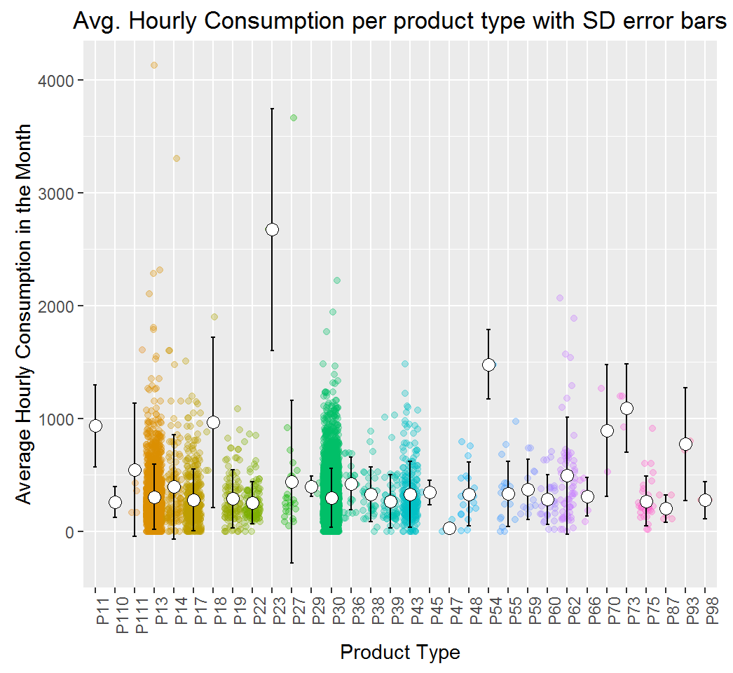
Dispersion of the energy consumptions across products for customer located in Madrid
Key observations
P13, P17,P30 satisfy two conditions that make customers in these product ideal for our subsequent analysis
Contain most of the customers in our data
Exhibit some of the lowest standard deviation
Therefore, based on the std. deviation we can assume that customers in these product a very similar in terms of the amount of energy they consume
P13, P17 and P30 customers will be the focus on the rest of the analysis

Slide 13

5 main analyses will be performed focused on customers in Madrid during a 6 month period
Datasets for analysis
Analysis to be performed
A new dataset just focused on Madrid customers will be derived from the full dataset:
City: Madrid
Products: P17, P13, P30
Dates: Jan '15 through Jul '15
Weather dataset downloaded from wunderground.com
City: Madrid
Features: Max temp in day, humidity,
wind speed
Dates: May '15 through Jul '15
1
Impact of AC usage in energy consumption
2
Correlation between temperature and energy consumption
3
Customer clustering based on weekly
energy consumption
4
Customer clustering based on day of the week percentage energy consumption
5
Identifying when customers are away from home based on historical energy usage

Slide 14
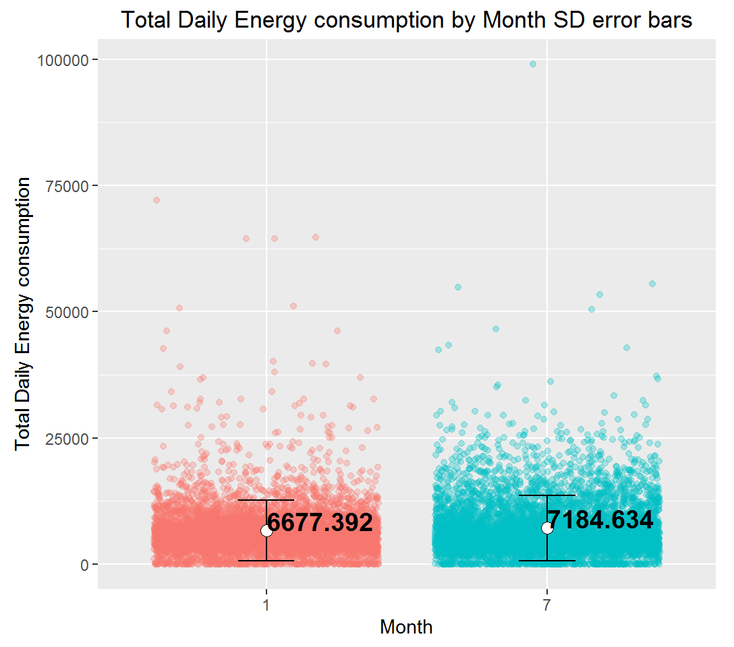
Significant difference in the energy consumed between January and July, most certainly due to increase in AC usage
1
Impact of AC usage
Data analyzed:
City: Madrid
Dates: Jan '15 vs. July '15
Products: P13, P30, P17
January sample is not normally distributed based on Jarque Bera Test
January sample is not normally distributed based on Jarque Bera Test
Given that both samples are not normally distributed, a non-parametric test (Wilcox test) was use to test significance of diff between averages
Difference of means is significant with p-value = 5.088e-06

Slide 15
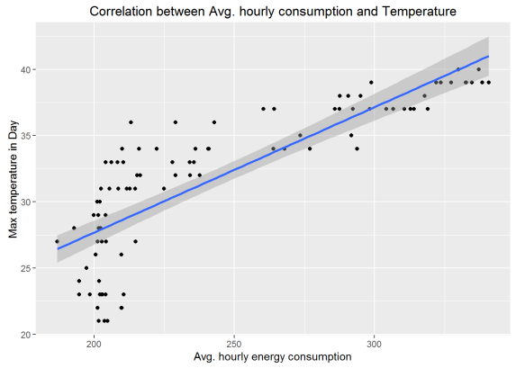
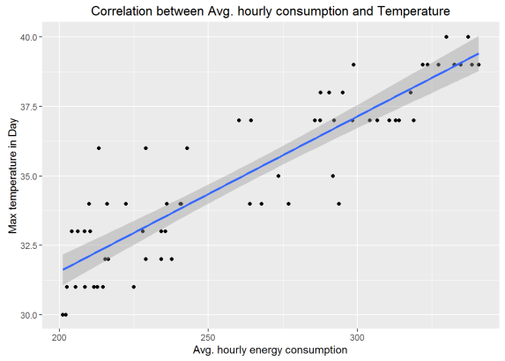
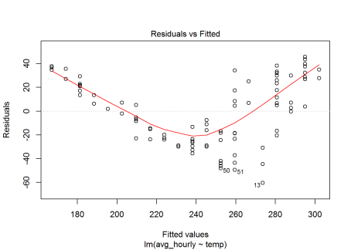
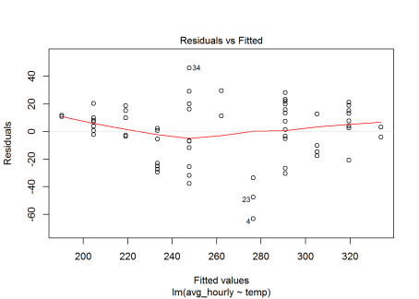
High correlation between energy consumed in the Madrid region and the temperature of the day
2
Correlation between temperature and energy
Correlation A: All days included¹
Correlation B: Only >30º days¹
Total energy consumed in Madrid per day for May, June and July month:
Strong correlation (p-value: < 2.2e-16)
Residuals plot show less strong correlation for days with temps below 30º
Correlation including just days with more than 30º still highly significant and residuals plots show smaller number of errors
Still strong correlation (p-value: < 2.2e-16)
Residuals show random pattern (i.e. optimal )
Day temp vs. day energy usage
Day temp vs. day energy usage
Selecting just days with temperature >= 30º
Residuals
Residuals
Below a ~30º, customers do not turn their AC unit and therefore energy usage is less strongly correlated with external temperature
1. For this analysis the energy dataset was blended together with weather dataset, more details in full report

Slide 16
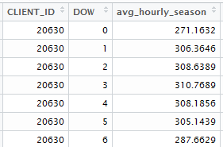
Overview of clustering customers based on average weekly energy consumption
3
Customer clustering based on weekly energy consumption
Objectives and context
Data manipulation for clustering
Goal: group together customers with similar weekly energy usage pattern
Clustering analysis should be able to answer questions like:
Which group of customers spend more on Tuesdays vs. Wednesdays?
Which customers spend more energy in the weekends vs. weekdays?
We will be using the following dataset used for clustering analysis:
City: Madrid
Dates: Jan '15 through Feb '15
Products: P30
Total customers: 3563
We will prepare an aggregated dataset that will have the following structure:
For each customer and each day of the week (Mon-Sun):
Avg hourly energy consumption on that day of the week during selected period
Aggregated data for clustering¹
0 = Sunday,
1 = Monday, etc.
Average hourly energy taken across 3 months of data (kWh)
1. Data preparation also involved removing outliers and incomplete data, more details in full report

Slide 17
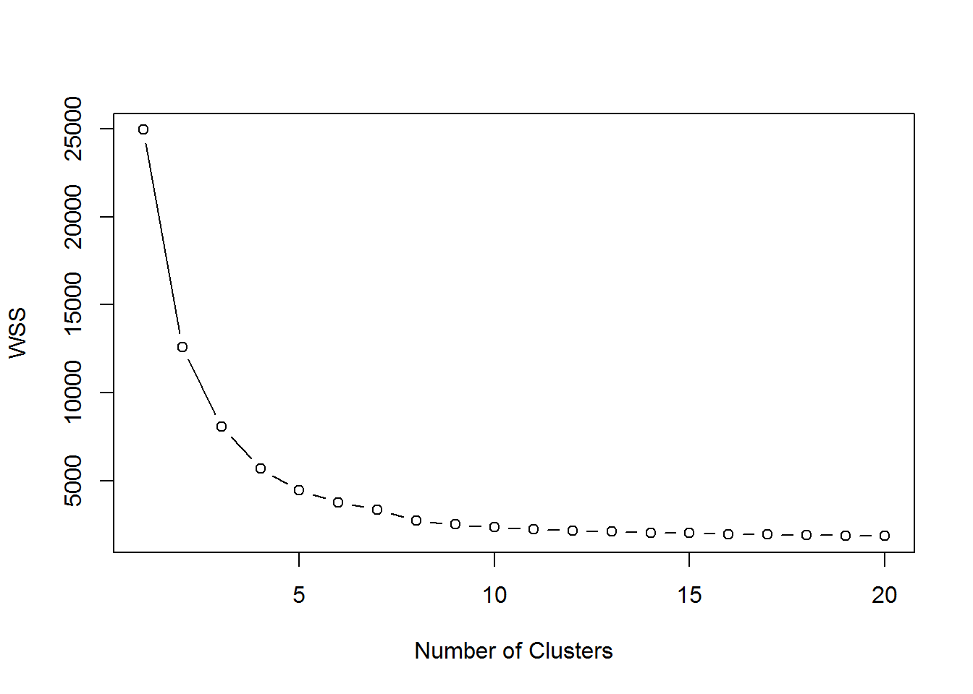
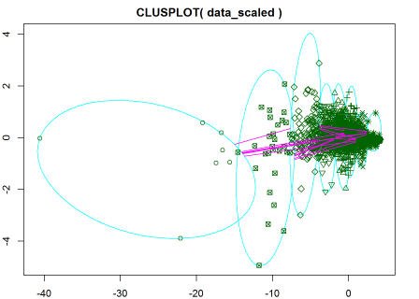
20 runs of k-means algorithm reveal that k=8 seems to be the optimal number of clusters
3
Customer clustering based on weekly energy consumption
20 runs are summarized in a WSS plot
20 runs of k-means
k=2 to 20
Normalized
dataset
k=8

Slide 18
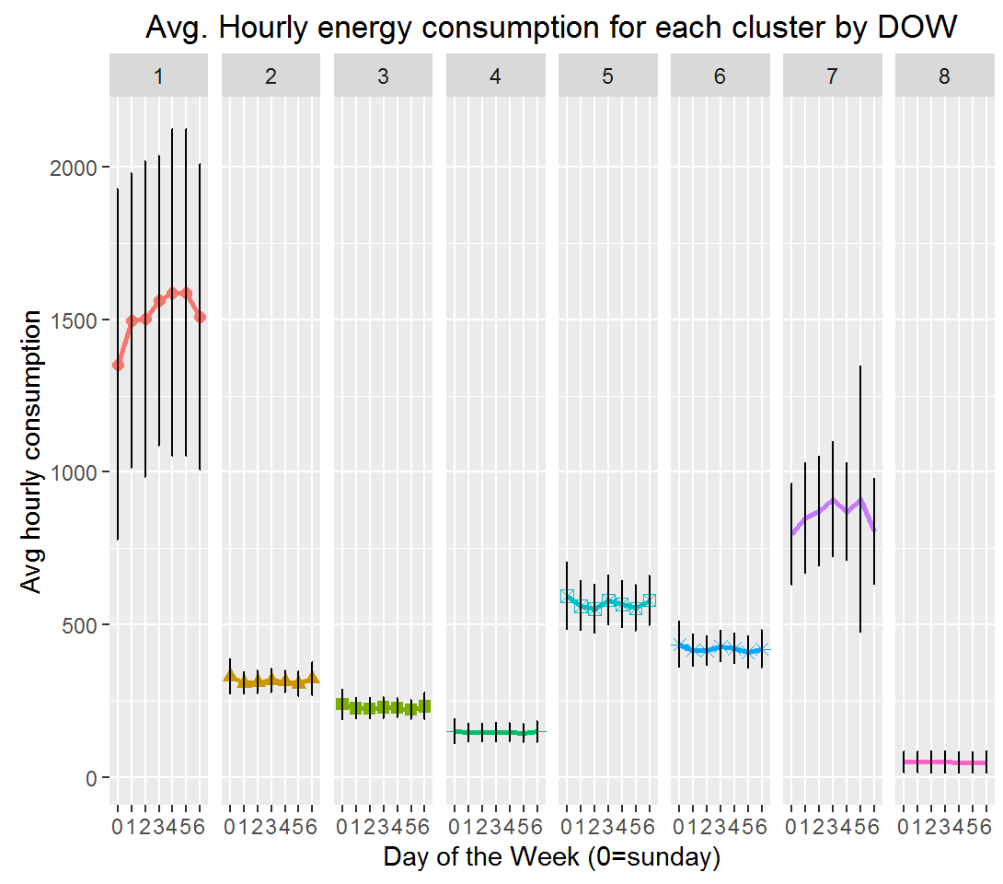
Analysis revealed ~4 clusters of customers with very similar energy usage and a flat weekly pattern
3
Customer clustering based on weekly energy consumption
Aggregated view of each cluster
Conclusions and next steps
Averaged together customers in same cluster (clusters 1 through 8)
Each cluster includes avg. hourly cons per day of the week
Observations from clustering results
Clusters 2, 3, 4, 8: share a very similar level of energy usage and a very flat pattern of usage throughout the week
Clusters 1, 7: std. dev error bars indicate a very high dispersion therefore, not that relevant
Clusters 5, 6: Seem to be an slight spike in energy consumption around the middle of the week
Very consistent and flat pattern in terms of energy usage throughout the week. In other words, seem that most of the customers spend the same level of energy every day of the week
Next steps to better model the usage weekly pattern of energy consumption
In section 4 we will follow another approach to better group customers based solely on their usage pattern (not including energy amount)

Slide 19
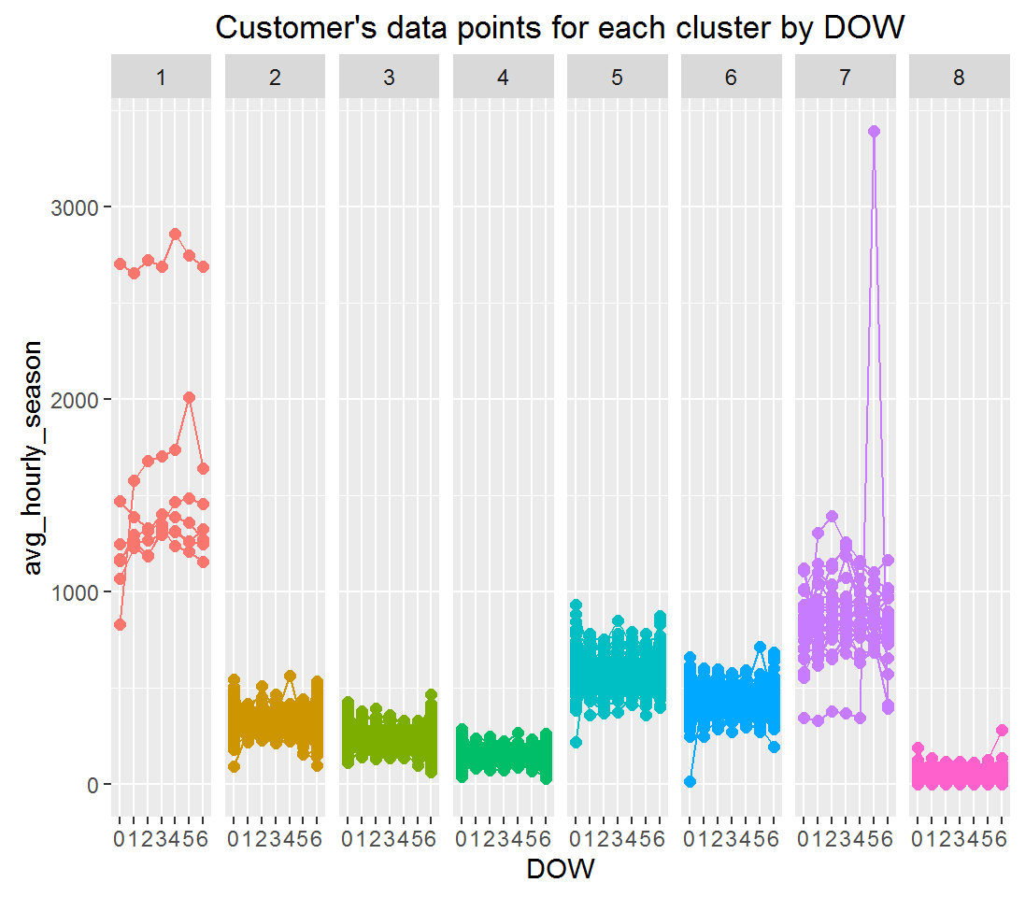
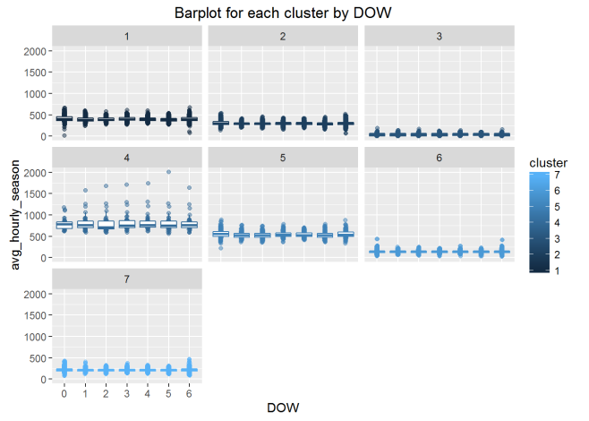
Additional views of the 8 clusters identified
3
Customer clustering based on weekly energy consumption
Customers data points for each cluster
Bar plots for each cluster
Low number of data points
High dispersion
Low number of data points
High dispersion, clear outlier

Slide 20
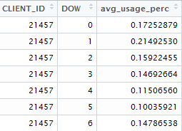
Overview of clustering customers based on day of the week percentage energy consumption
4
Customer clustering based on day of the week percentage energy consumption
Objectives and context
Data manipulation for clustering
Goal: group together customers with similar weekly energy usage pattern, following different approach
This clustering analysis will group together customers based on the avg. percentage of energy consumed per day of the week
Previous clustering based on absolute value of energy consumed
Again, we will be using the following dataset used for clustering analysis:
City: Madrid
Dates: Jan '15 through Feb '15
Products: P30
Total customers: 3316
We will prepare an aggregated dataset that will have the following structure:
For each customer and each day of the week (Mon-Sun):
% of energy consumed out of total week (averaged across the 3 months)
Aggregated data for clustering¹
E.g.: client 21457 on average consumes on Mondays ~21% of the total weekly energy bill
0 = sunday
(Avg) % of energy consumed in each given day out of total week
1. Data preparation also involved removing outliers and incomplete data and additional data manipulation to calculate percentages, more details in full report

Slide 21
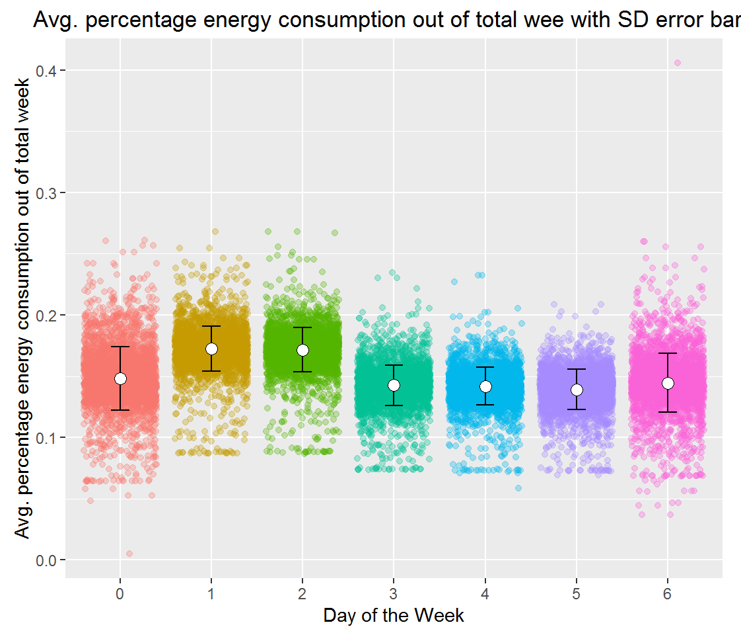
Preliminary findings: customers in Madrid tend to spend more energy on Mondays and Tuesday
4
Customer clustering based on day of the week percentage energy consumption
Preliminary findings
Aggregated view of how all customers in our dataset on average behave for each day of the week
Plot is result of aggregating dataset described in previous slide
Customers in Madrid tend to spend more energy on Mondays and Tuesday
Customers on average consume ~17% of the total energy spent in the week on these two days (respectively)

Slide 22
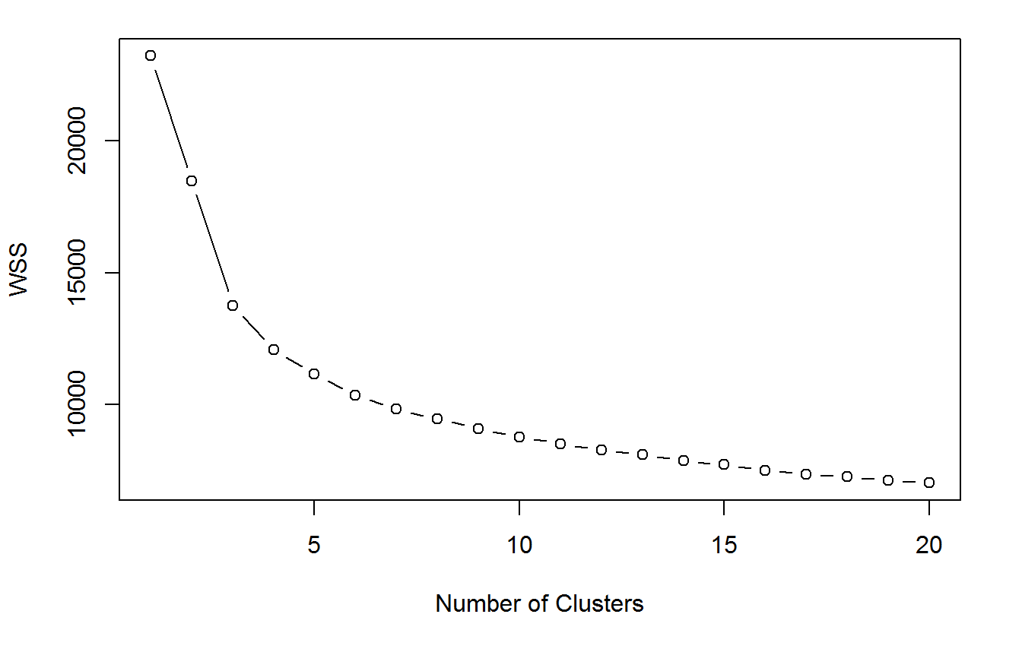
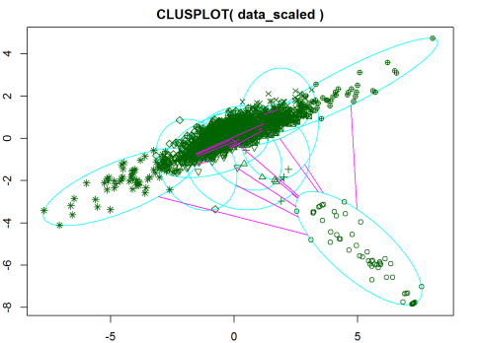
20 runs of k-means algorithm reveal in this case that k=10 seems to be the optimal number of clusters
4
Customer clustering based on day of the week percentage energy consumption
20 runs are summarized in a WSS plot
20 runs of k-means
k=2 to 20
Normalized
dataset
k=10

Slide 23
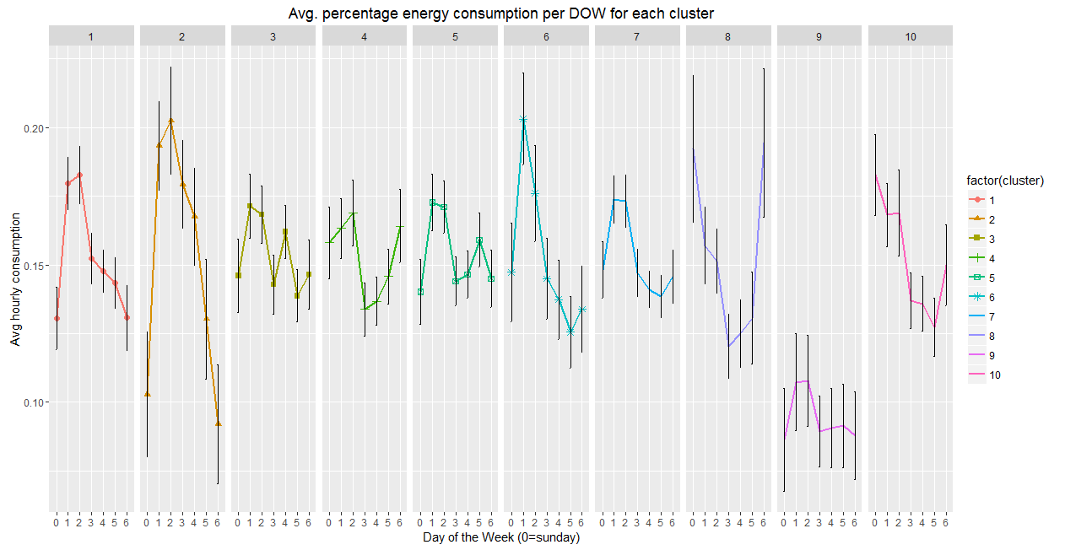
New clustering approach groups customers based on their weekly usage patterns
4
Customer clustering based on day of the week percentage energy consumption
"Stay-home weekends" cluster
"Mon-Tues heavy energy usage" cluster
Clustering run on this new dataset seems to have better group together customers that on average exhibit a similar energy usage pattern across the week. Some key conclusions
For more than half of the clusters obtained, the error bars look moderately low
Clusters 1, 2, 3, 5, 7: customers in these clusters tend to spend more on Mondays and Tuesdays and less during the weekends
Clusters 4, 8, 10: seems to spend significantly more at least in one of the weekend
On average customers tend to spend on a single day no more than 20% of their total weekly energy consumption

Slide 24
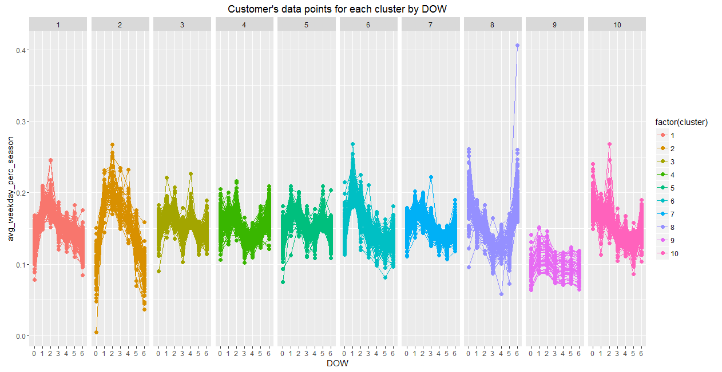
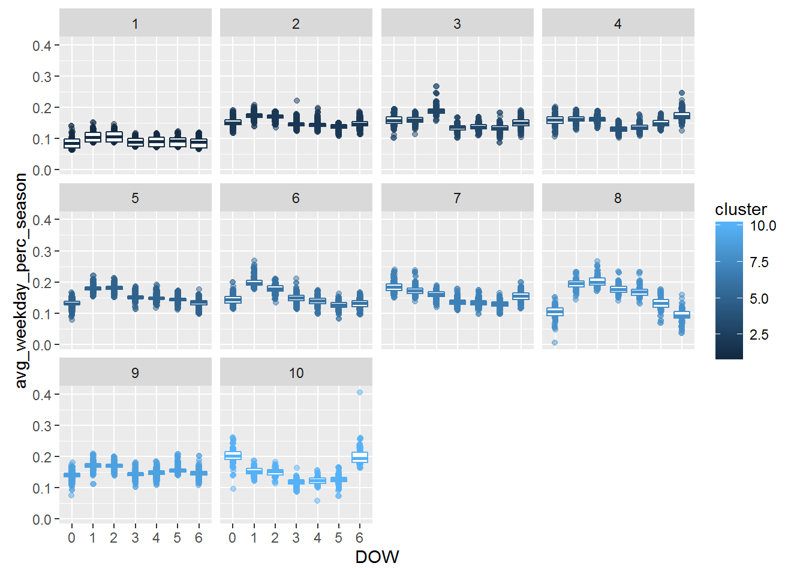
Additional views of the 10 clusters identified
4
Customer clustering based on day of the week percentage energy consumption
Customers data points for each cluster
Bar plots for each cluster

Slide 25
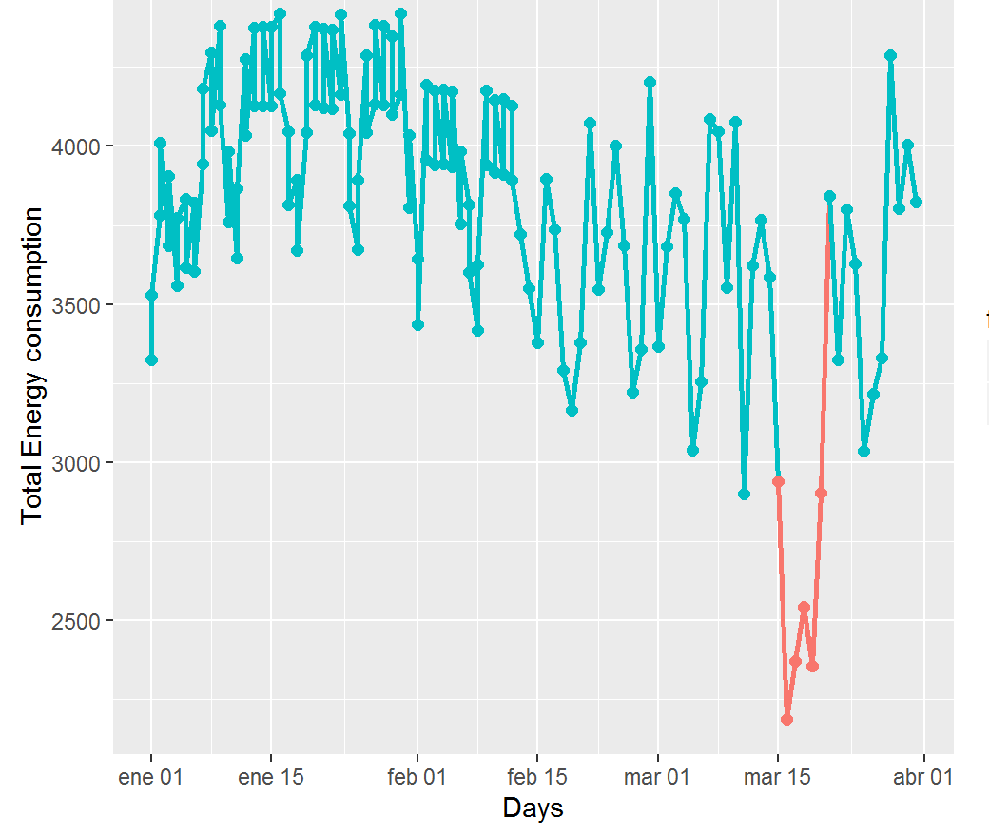
Historical energy usage can help identify when customers are away from home
5
Identifying when customers are away
Data Set
We will be analyzing customers in the same dataset that was used for clustering
City: Madrid, Dates: Jan '15 through Feb '15, Products: P30
Total customers: 3466
Avg. energy usage
per DOW¹
Calculate for each customer and each DOW: ²
Avg. energy usage across the 3 months (avg_energy_dow)
Std. Dev of energy usage across the 3 (stdev)
Identify "away-from-home"
For each day and customer in the dataset:
If Energy consumed in the day < (avg_energy_dow – stdev*2)
Then, we flag the customer as "away-from-home" for this day
Output (selected customer)
Days in red indicate that customer is probably away from home based on method above
1. DOW: Day of the week 2. Avg and Std were calculated by DOW since for a given customers the energy usage can vary between different days of the week

Slide 26
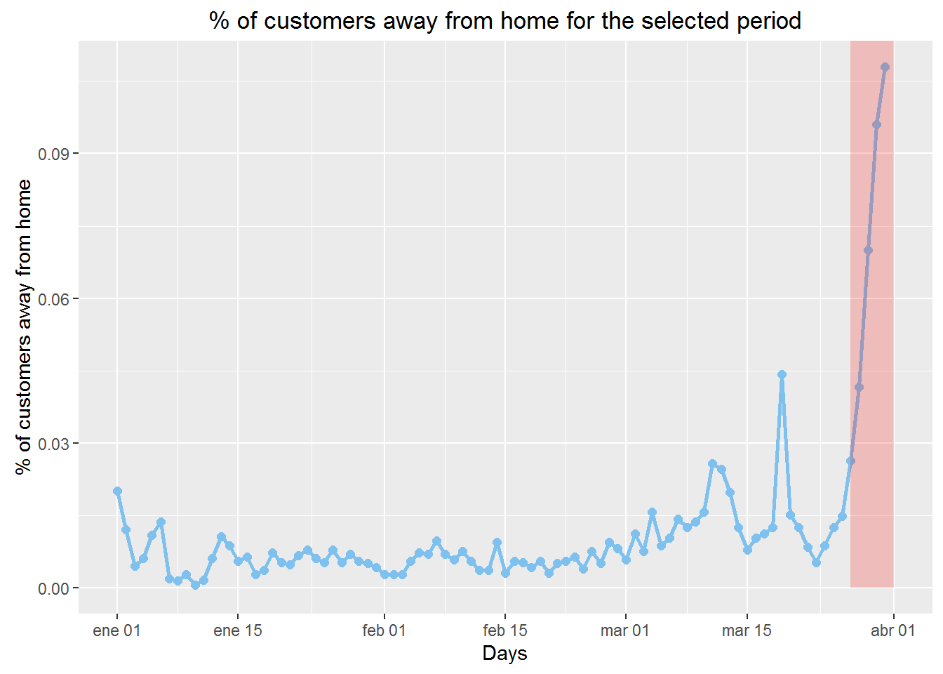
Analysis revealed a high number of Madrid customers away from home during Easter break 2015
5
Identifying when customers are away
Aggregated results
Results from the analysis were aggregated to determine:
% number of customers away from home for each day of the period between January 2015 and April 2015
Easter break¹ explains the sudden increase in the number of customers flagged as "away-from-home" was on method described previously
1. In 2015 Easter break ( "Semana Santa" in Spanish) occurred between 27/03/2015 and 03/04/2015

